Slide 1
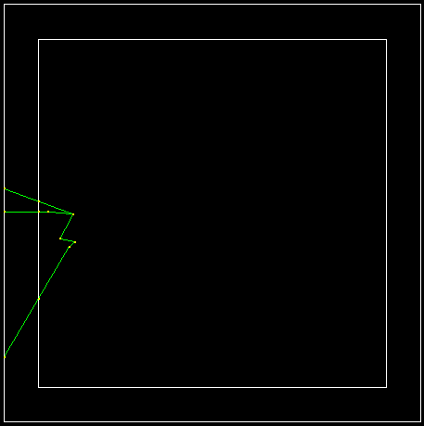
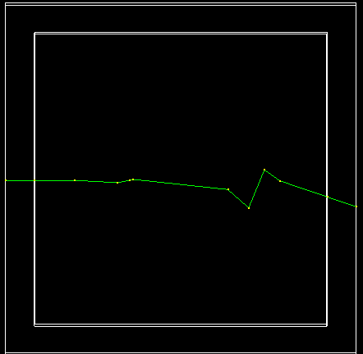





Examples of 2.5 MeV neutron interaction sequence in LArTPC
$n$enters the detector, scatters elastically multiple times and exits the detector.
$n$captured on Ar and performs ⁴⁰Ar(n,n’)⁴⁰Ar process.
$$γ$$
$n$’
⁴⁰Ar(n,n’)⁴⁰Ar vertex
$$n$$
10 cm
10 cm
10 cm
10 cm
Notes:
Here are the lessons learned so far in my summer project. First, a couple of examples of neutron interaction cascade in LArTPC in the relevant energy range for protoDUNE

Slide 2
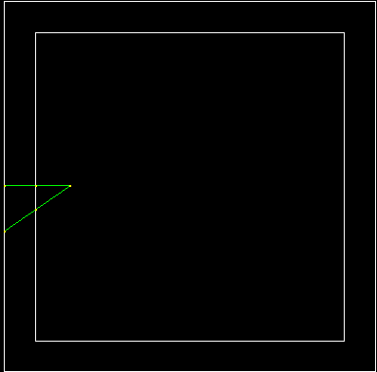
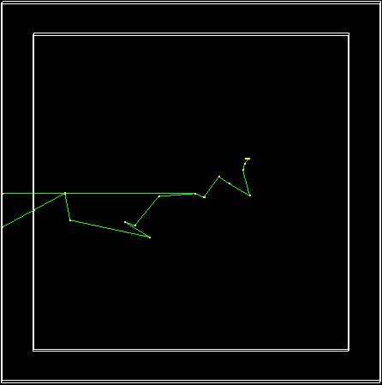
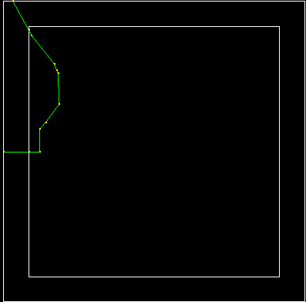






Examples of 2.5 MeV neutron interaction sequence in LArTPC
$n$enters the detector, scatters elastically and exits the detector.
$n$captured on Ar and performs ⁴⁰Ar(n,n’)⁴⁰Ar process.
$$n$$
$$γ$$
$n$’
$n$enters the detector, scatters elastically multiple times and exits the detector.
⁴⁰Ar(n,n’)⁴⁰Ar vertex
20 cm
20 cm
20 cm
20 cm
20 cm
20 cm

Slide 3
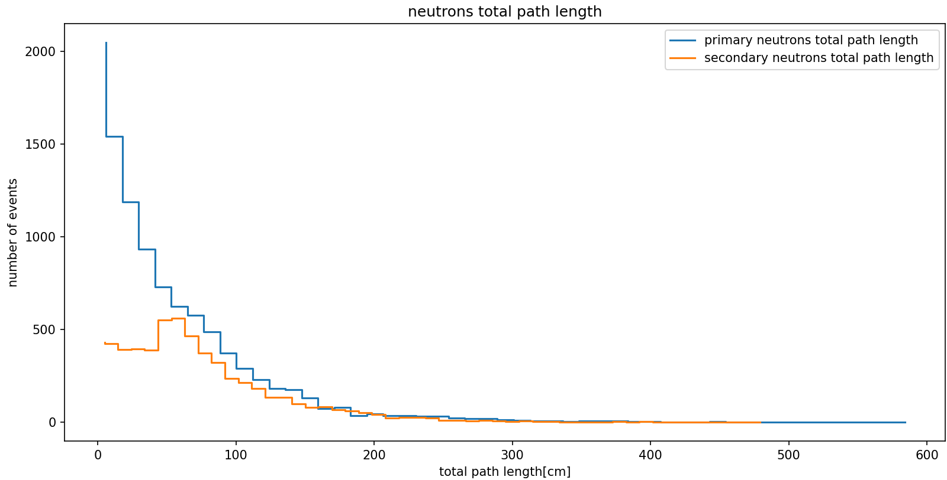

Slide 4
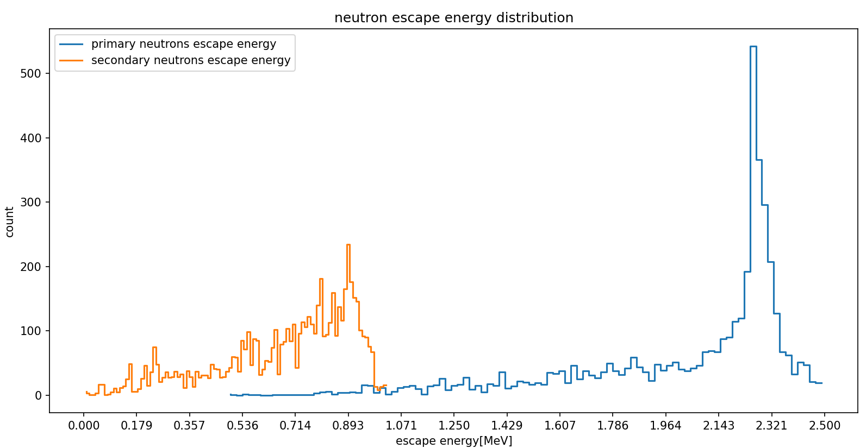


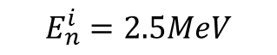
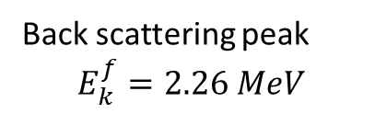
Detector size 1x1x1 meter
Back scattering peak
$$E_{k}^{f}=2.26 MeV$$
LAr
$$E_{n}^{i}=2.5MeV$$
$$E_{n}^{escape}$$
Stopped neutrons have energy = 0
In 58% of events there was an $(n,n’)$process

Slide 5
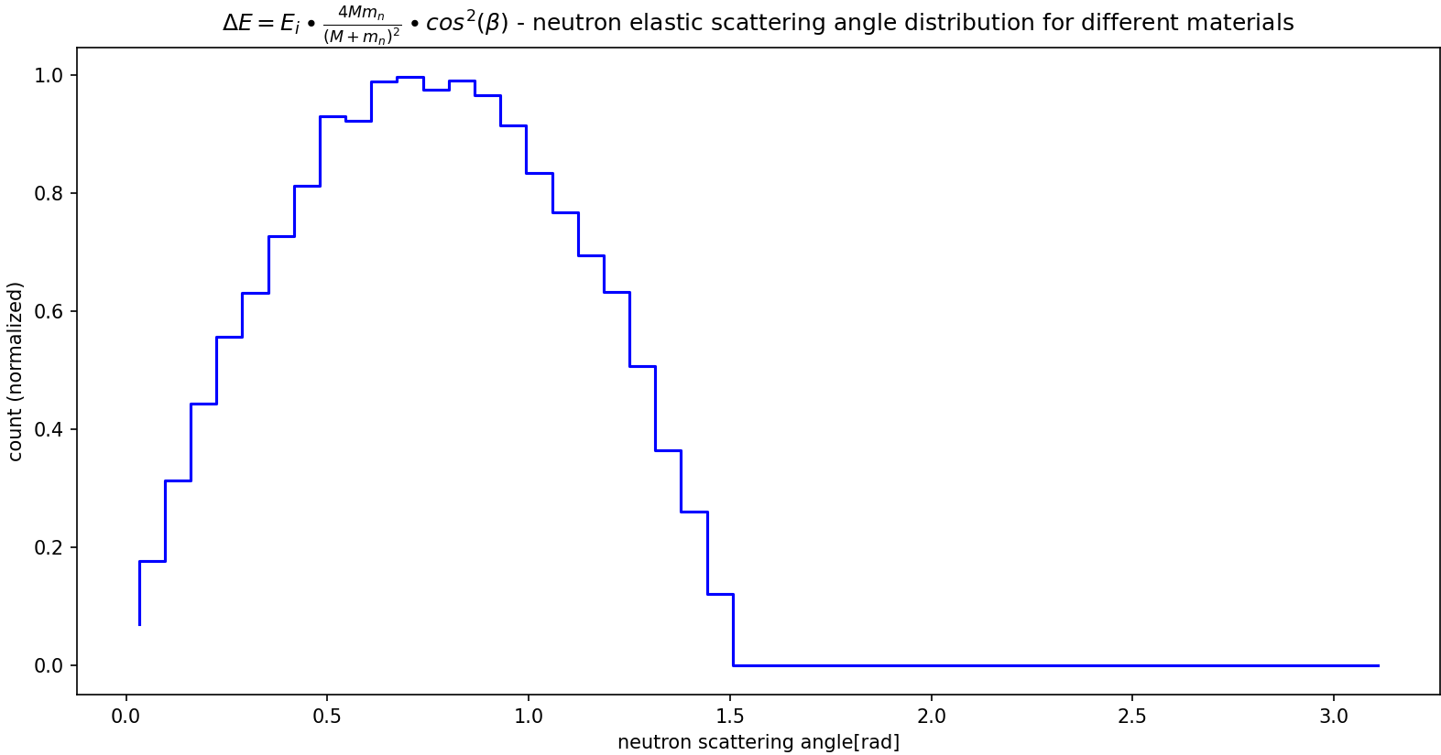
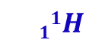
$$11H$$

Slide 6
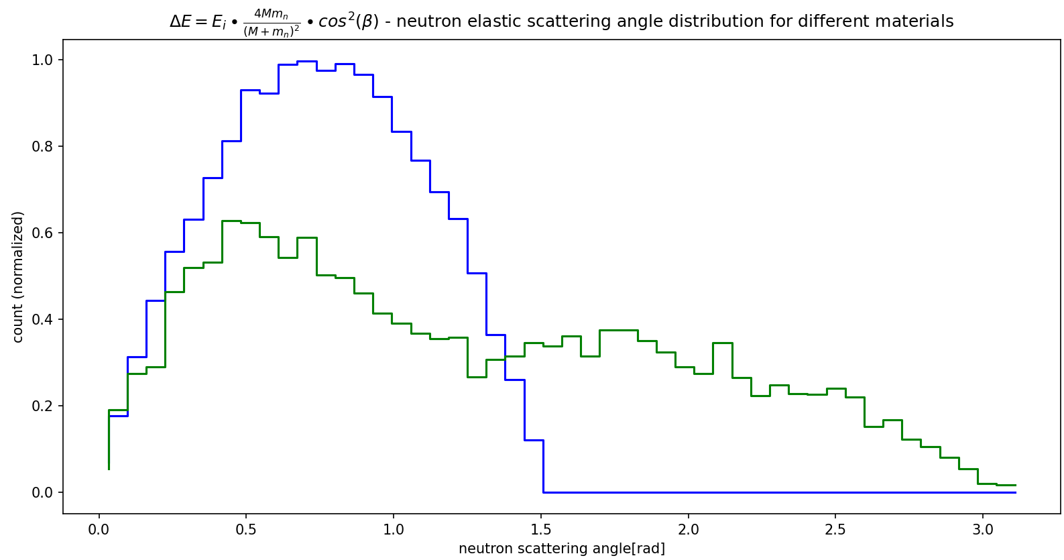
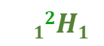
$$11H$$
$$12H1$$

Slide 7
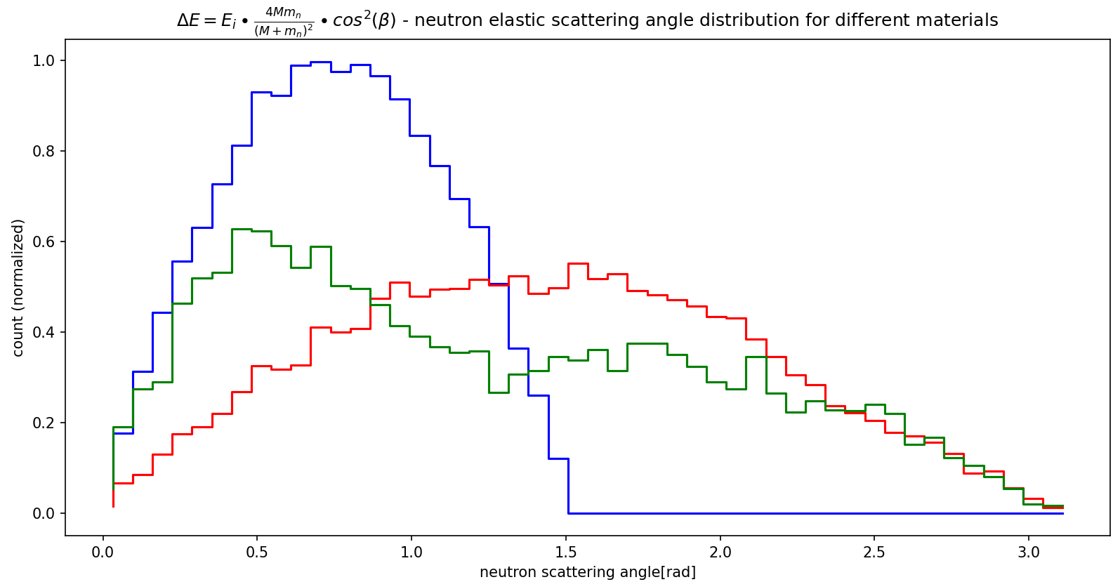
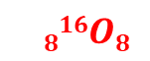
$$11H$$
$$816O8$$
$$12H1$$

Slide 8
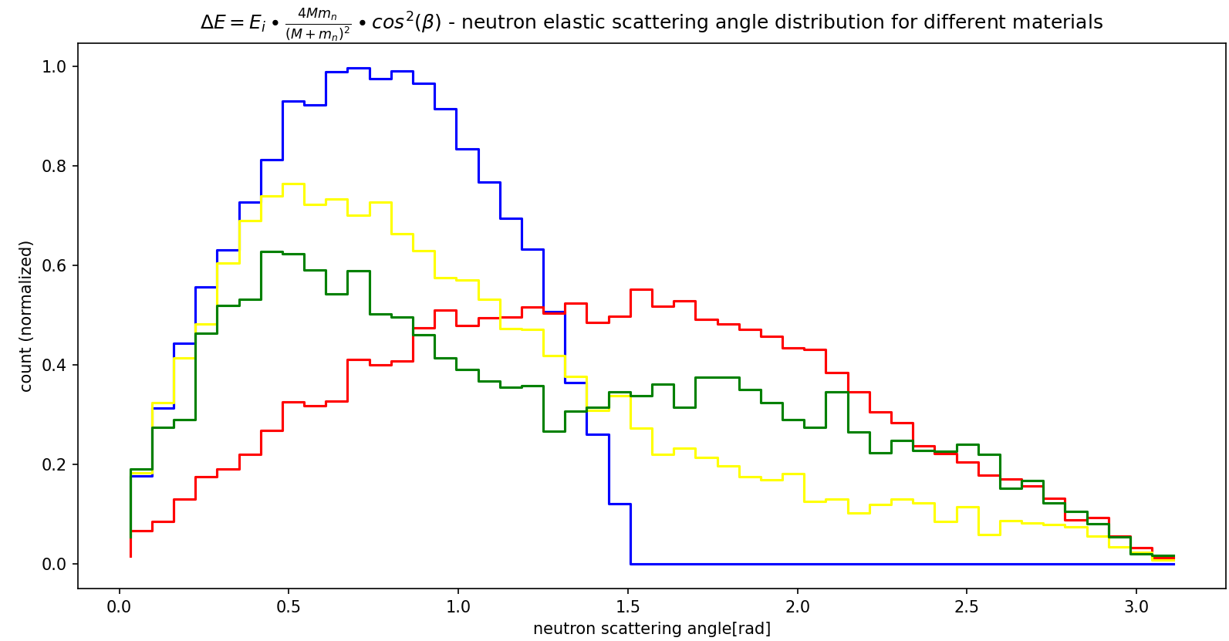
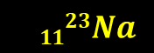
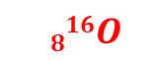

$$11H$$
$$1123Na$$
$$816O$$
$$12H$$

Slide 9
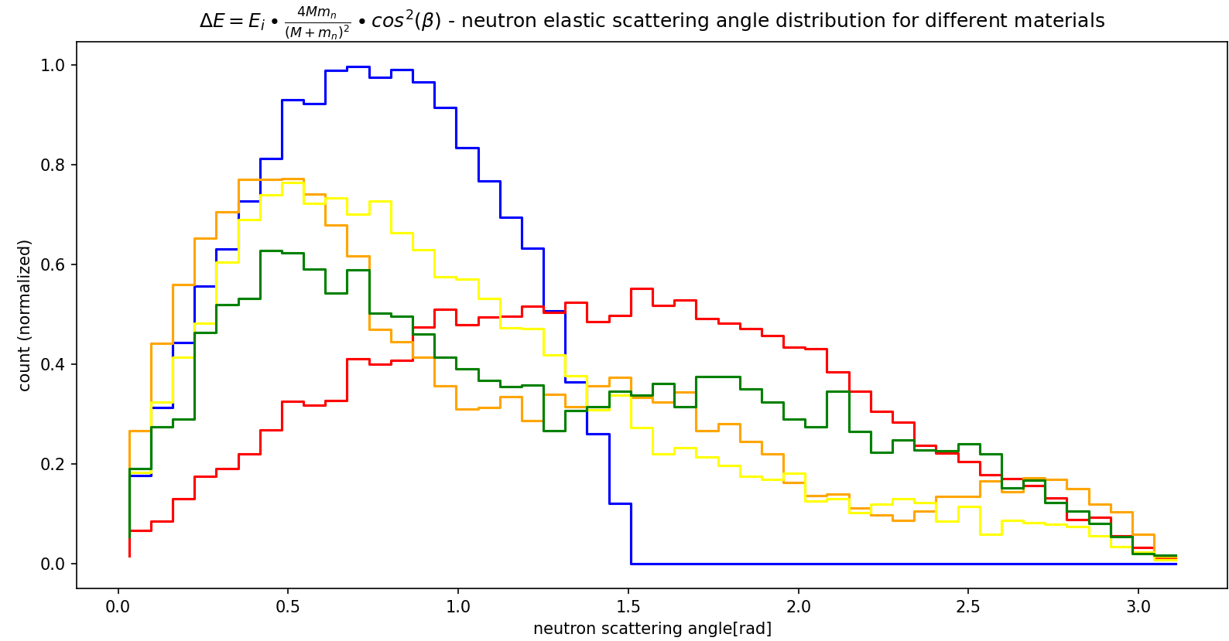


$$11H$$
$$1123Na$$
$$1428Si$$
$$12H1$$
$$816O8$$

Slide 10
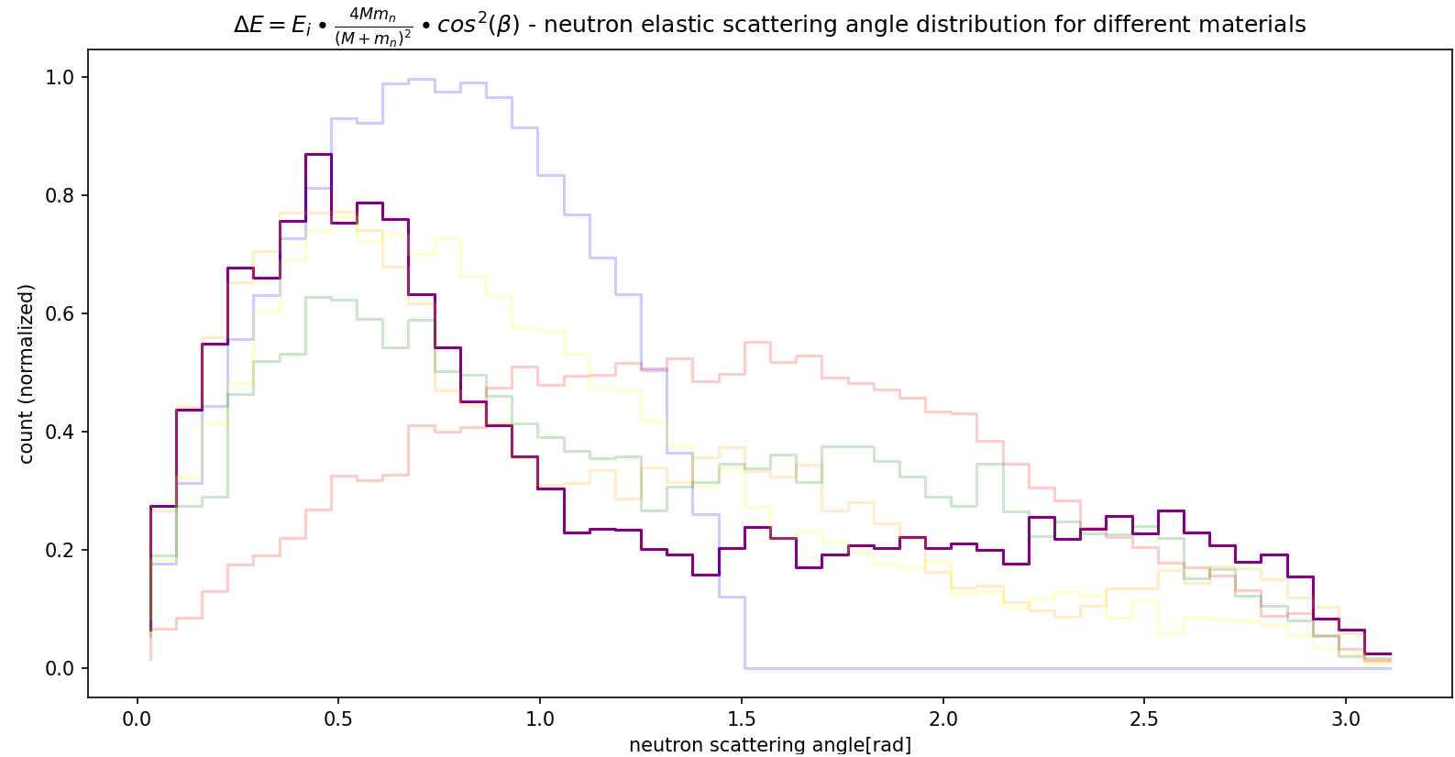
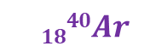

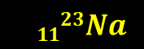
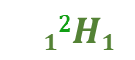
$$11H$$
$$1428Si$$
$$1123Na$$
$$12H1$$
$$816O8$$
$$1840Ar$$

Slide 11
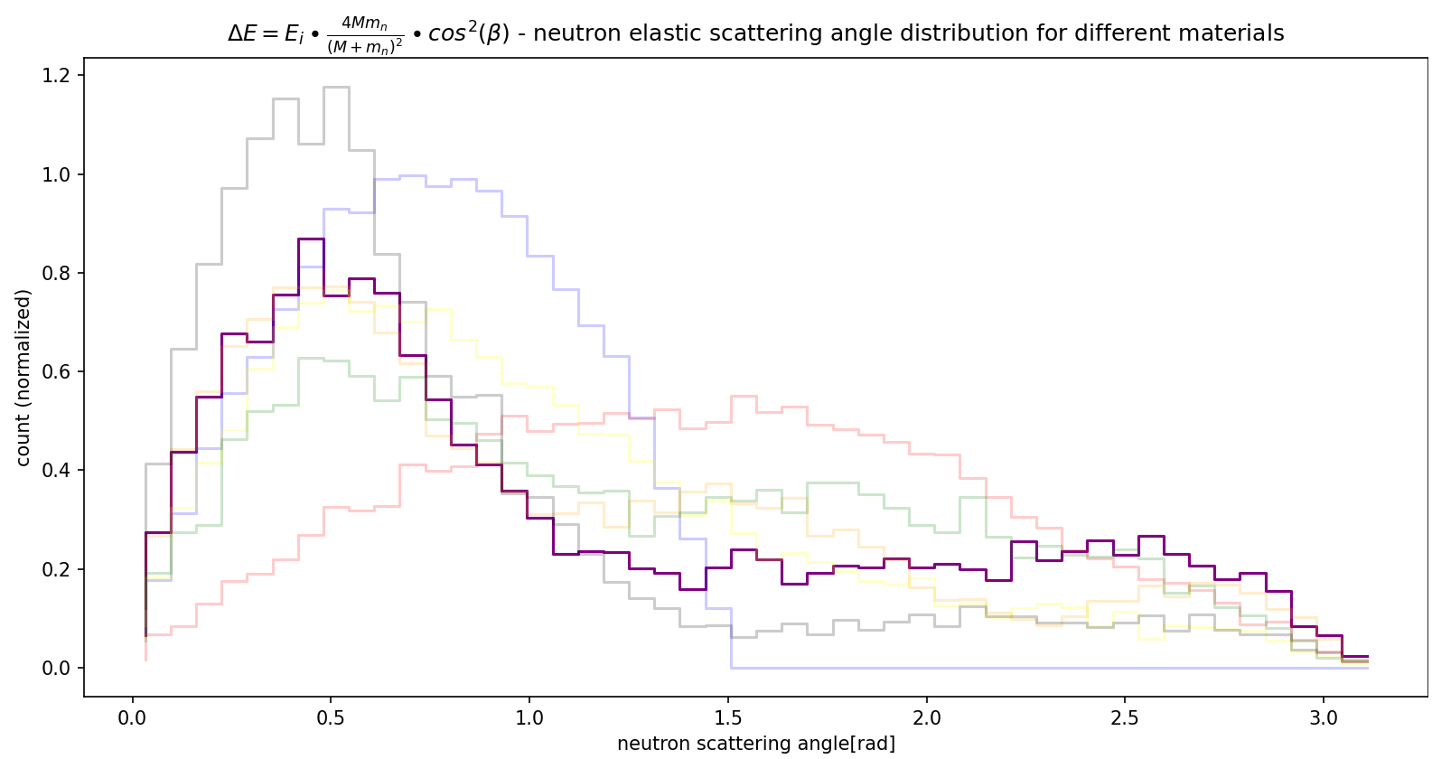

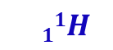


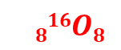
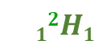
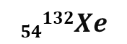
$$54132Xe$$
$$11H$$
$$1428Si$$
$$1123Na$$
$$12H1$$
$$816O8$$
$$1840Ar$$

Slide 12
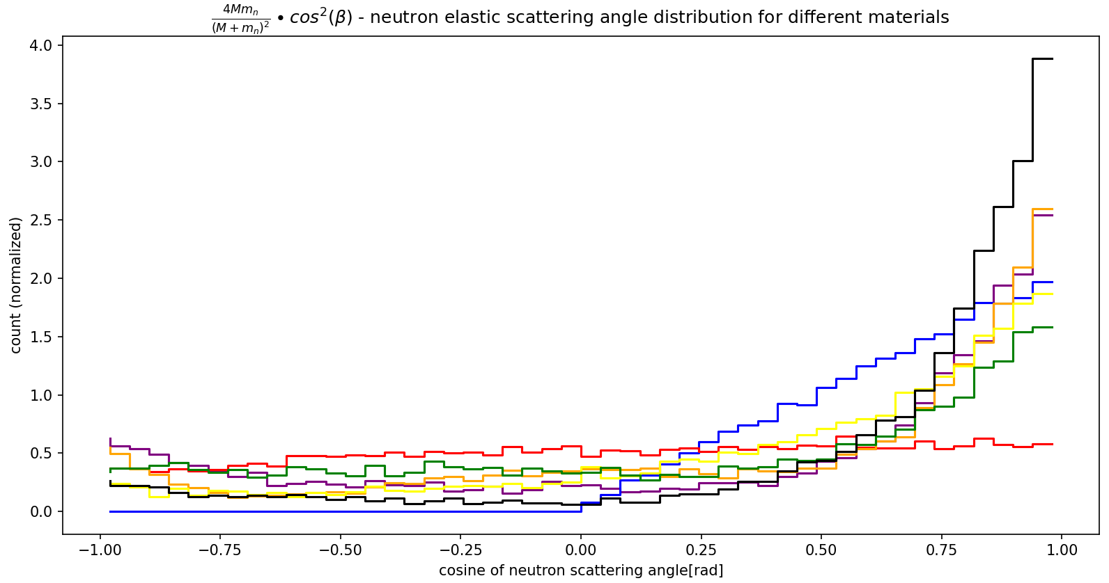

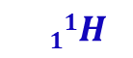

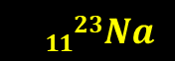
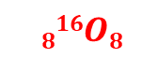
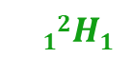
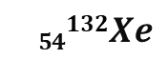
$$54132Xe$$
$$1428Si$$
$$12H1$$
$$11H$$
$$1123Na$$
$$1840Ar$$
$$816O8$$

Slide 13
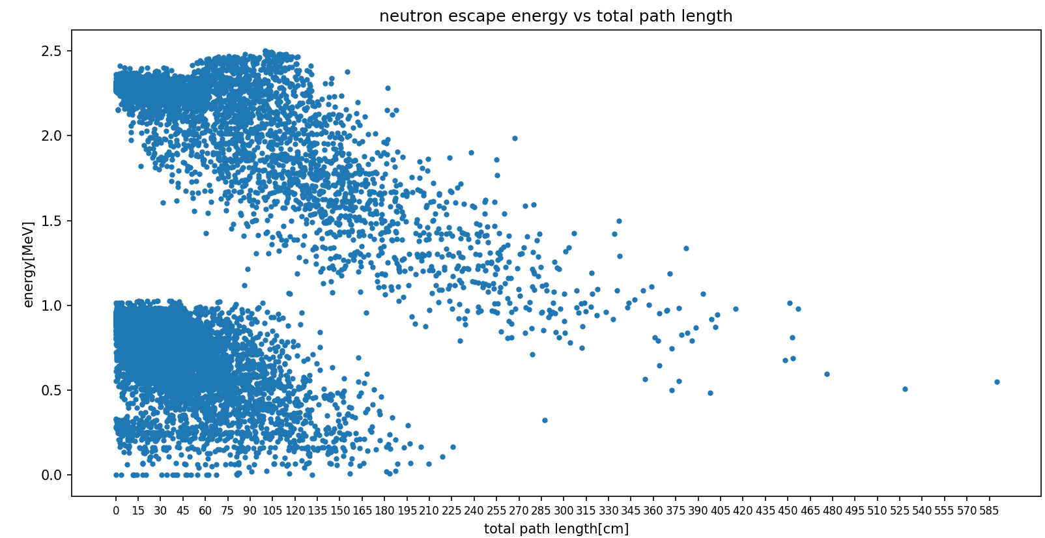
Detector size 1x1x1 meter
$$E_{k}^{i}=2.5MeV$$

Slide 14
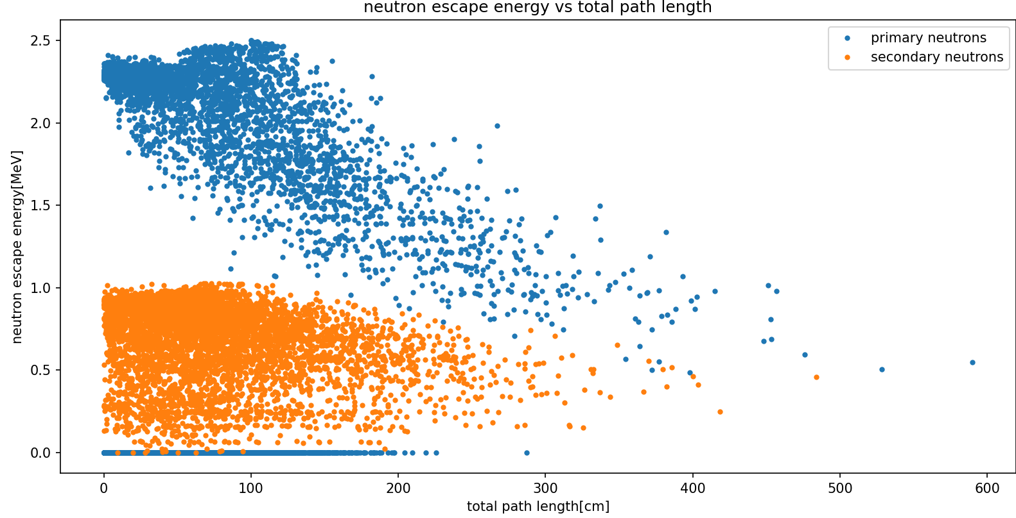
Detector size 1x1x1 meter
$$E_{k}^{i}=2.5MeV$$

Slide 15
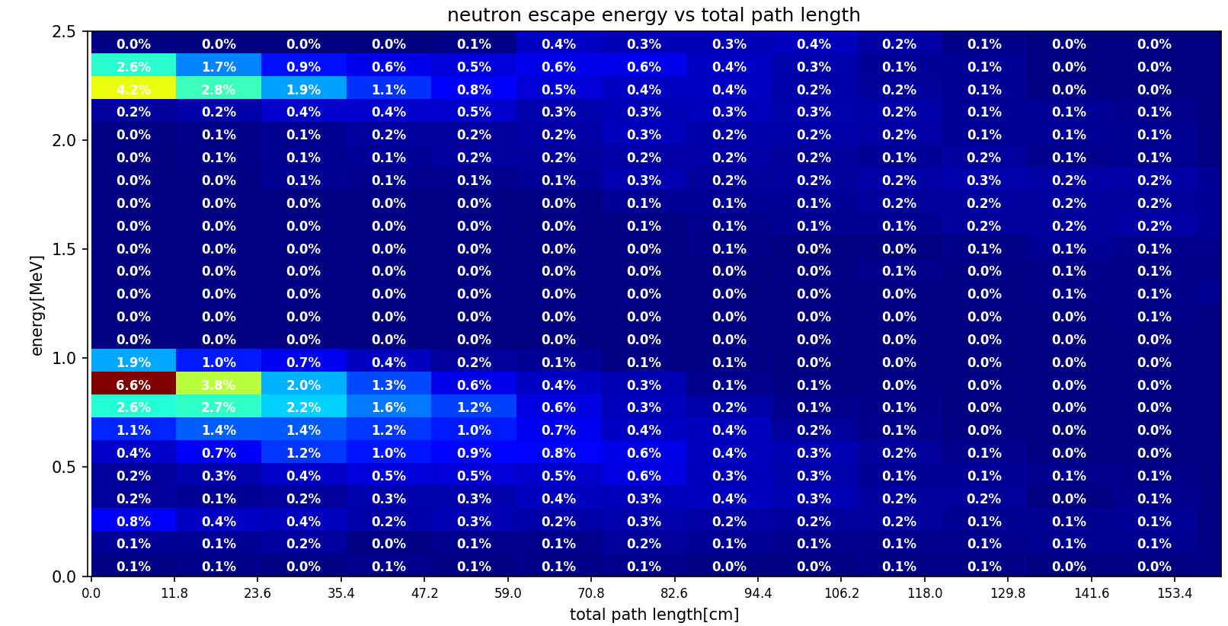
Detector size 1x1x1 meter

Slide 16
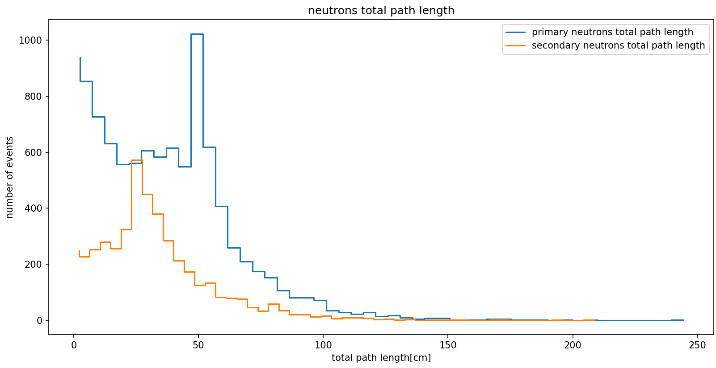
Detector size 0.5x0.5x0.5 meter
$$E_{k}^{i}=2.5MeV$$

Slide 17
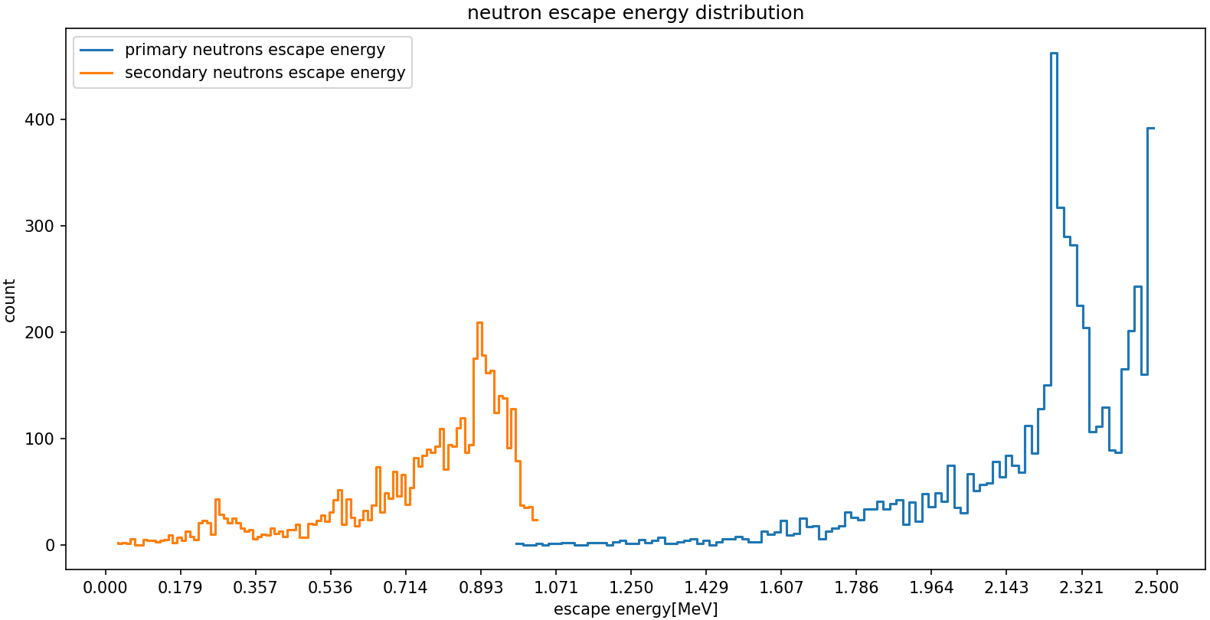

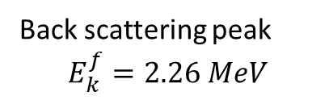
Detector size 0.5x0.5x0.5 meter
Back scattering peak
$$E_{k}^{f}=2.26 MeV$$
0 interaction neutrons
$$E_{k}^{i}=2.5MeV$$
Stopped neutrons have energy = 0
In 45% of events there was an $(n,n’)$process

Slide 18
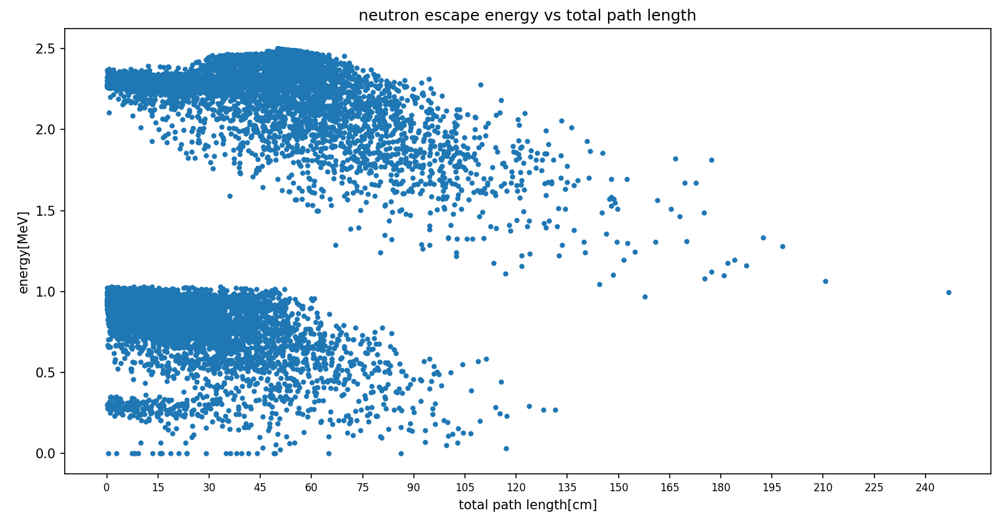
Detector size 0.5x0.5x0.5 meter
$$E_{k}^{i}=2.5MeV$$

Slide 19
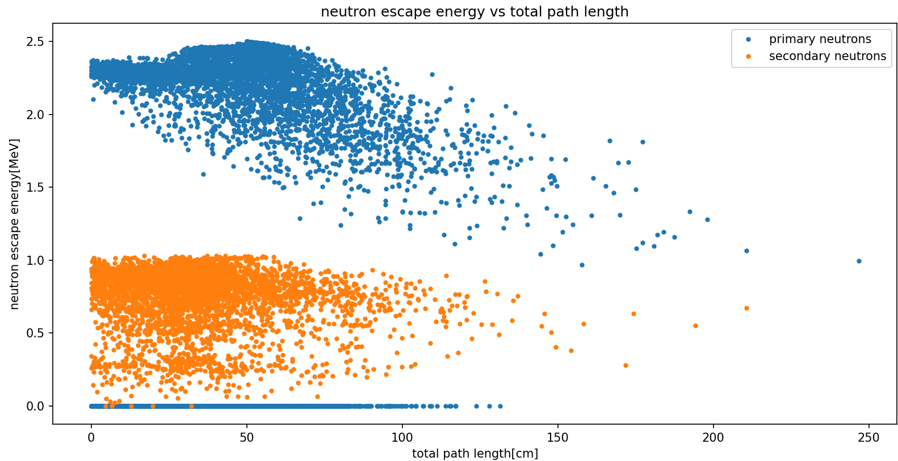
Detector size 0.5x0.5x0.5 meter
$$E_{k}^{i}=2.5MeV$$

Slide 20
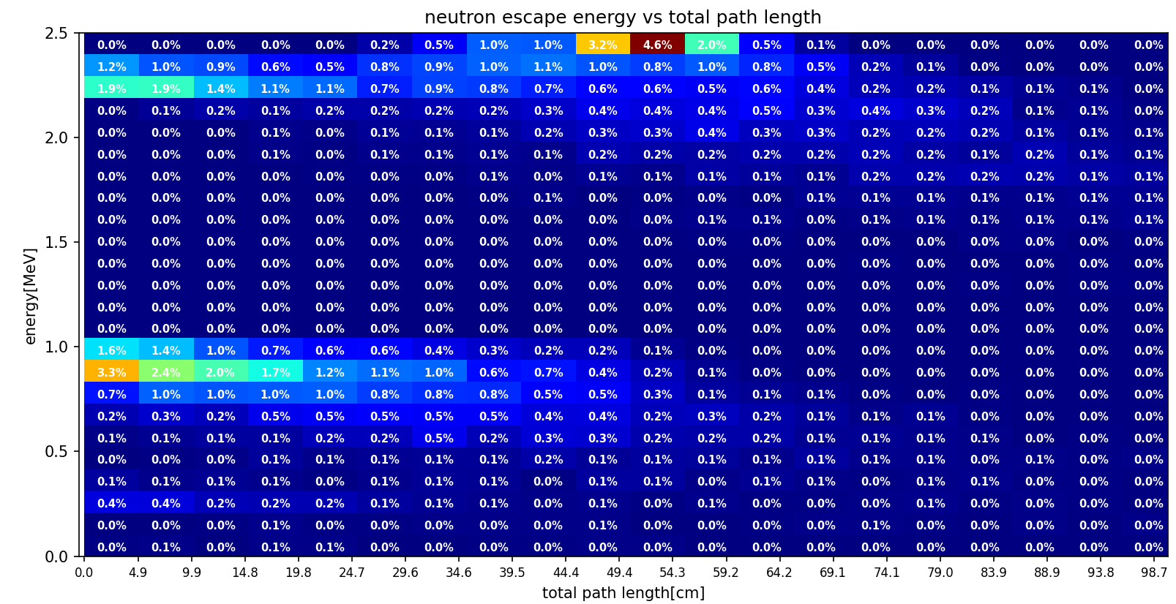
Detector size 0.5x0.5x0.5 meter

Slide 21
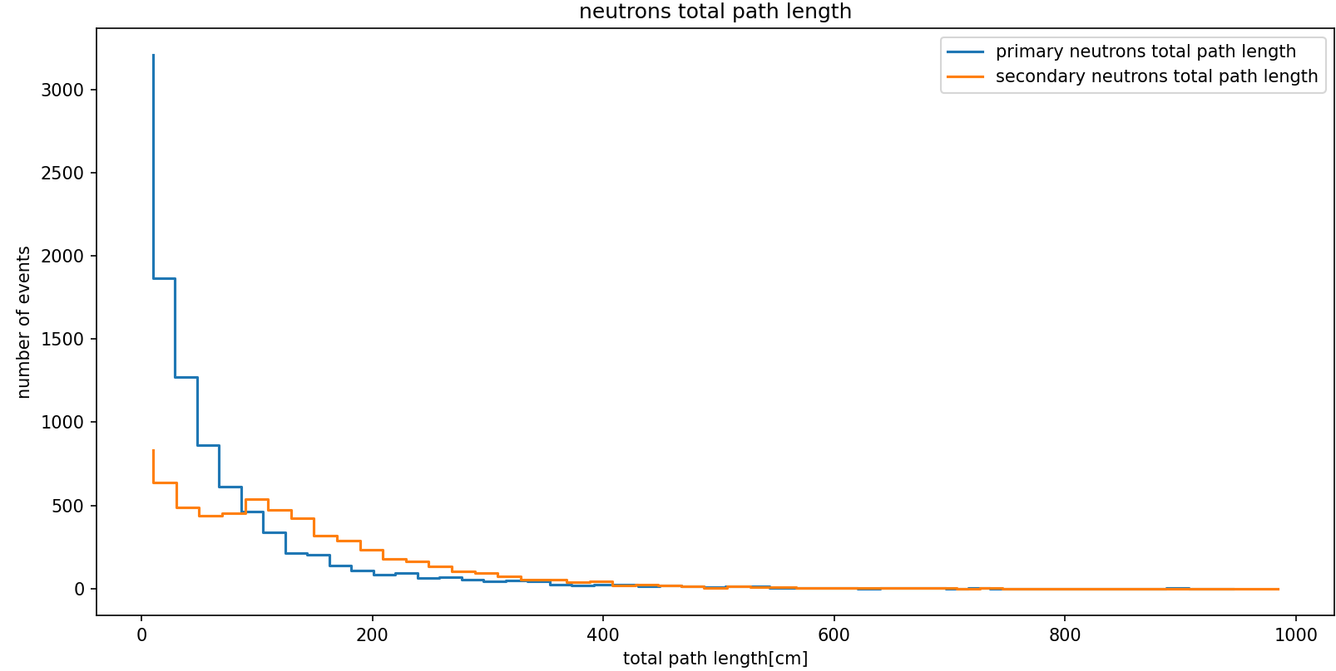
Detector size 1x2x2 meter
(thickness = 1m)

Slide 22
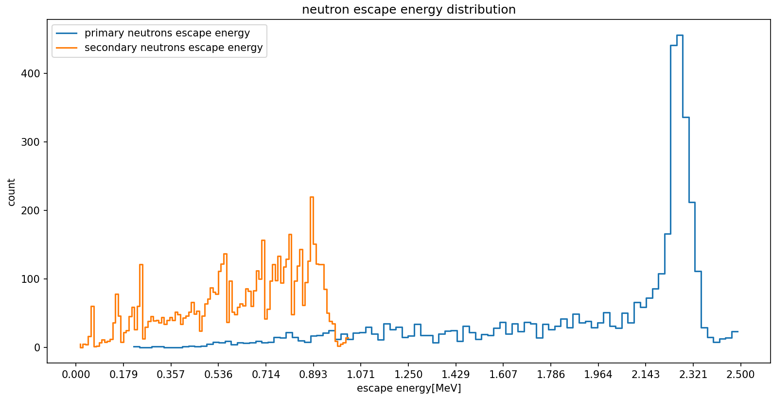

Detector size 1x2x2 meter
(thickness = 1m)
Back scattering peak
$$E_{k}^{f}=2.26 MeV$$
$$E_{k}^{i}=2.5MeV$$
Stopped neutrons have energy = 0
In 62% of events there was an $(n,n’)$process

Slide 23
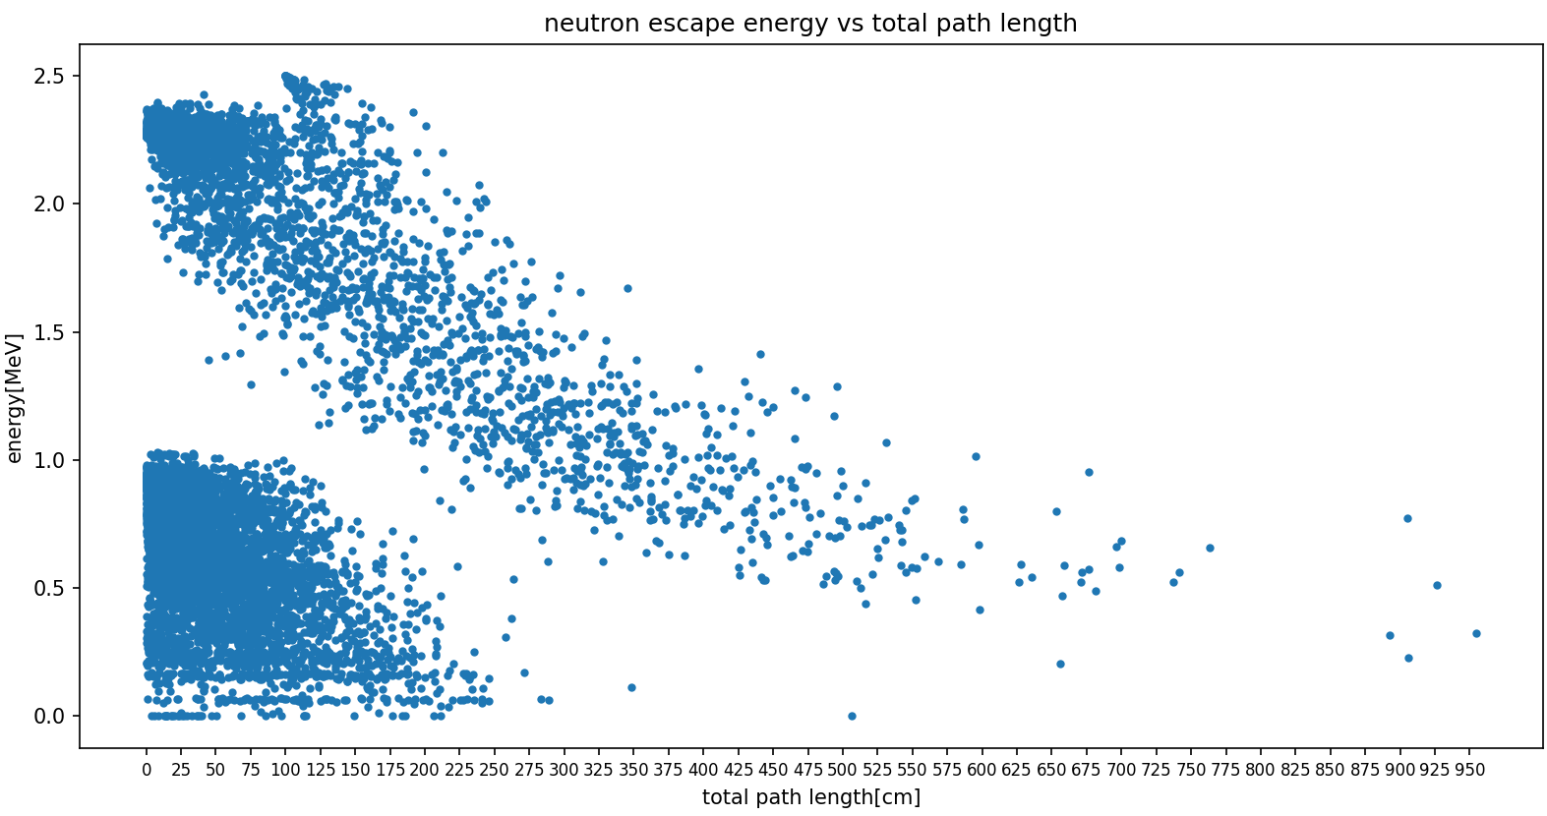
Detector size 1x2x2 meter
(thickness = 1m)
$$E_{k}^{i}=2.5MeV$$

Slide 24
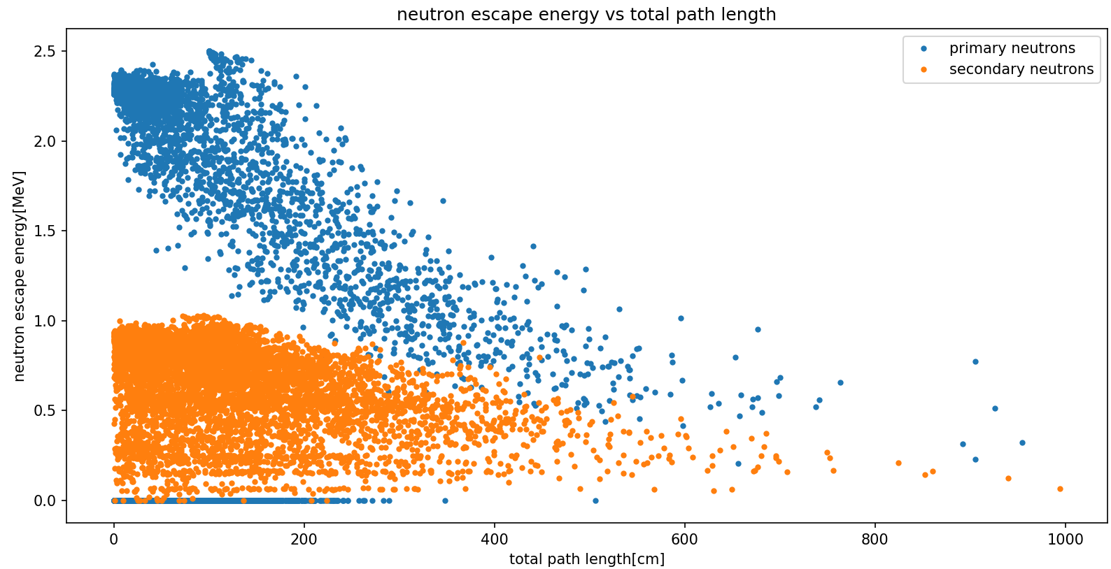
Detector size 1x2x2 meter
(thickness = 1m)
$$E_{k}^{i}=2.5MeV$$

Slide 25
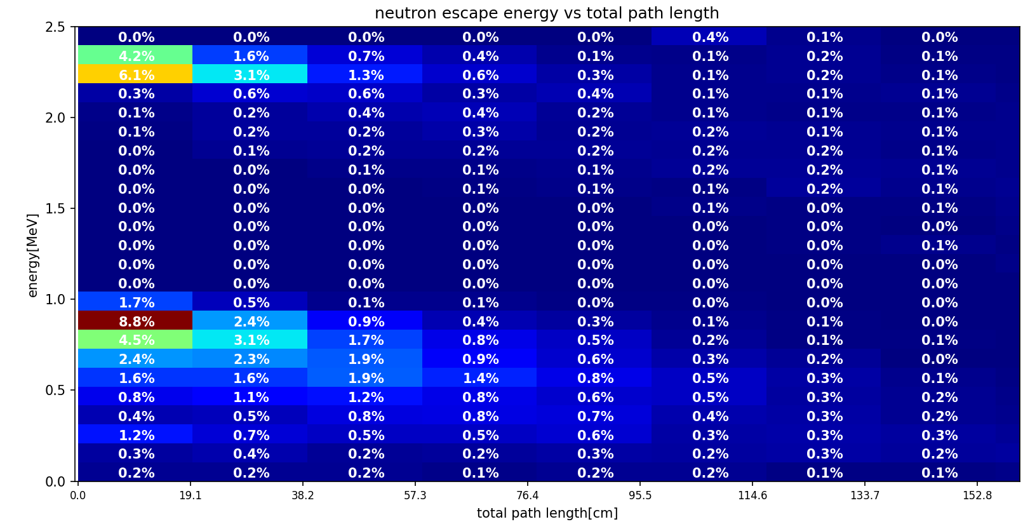
Only for primary neutrons (didn’t perform (n,n’))
Detector size 1x2x2 meter
(thickness = 1m)

Slide 26
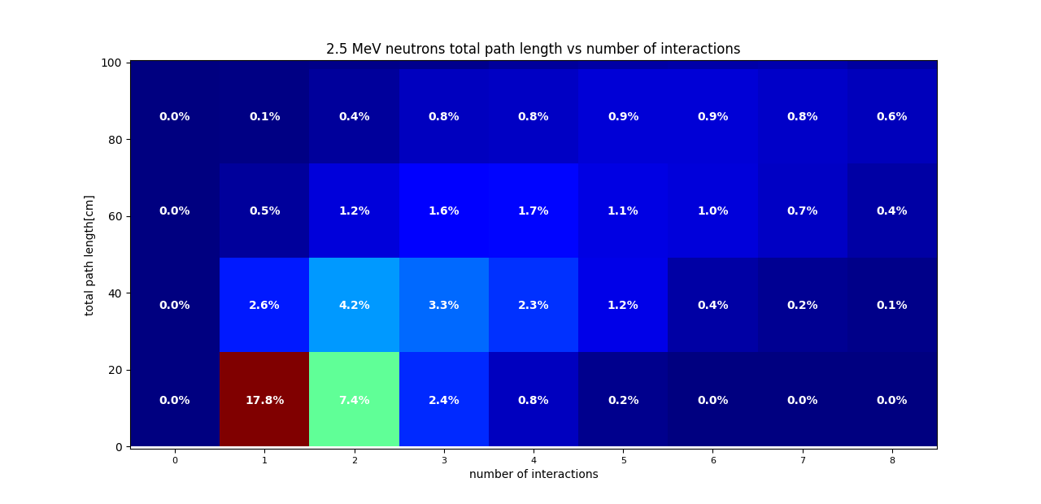
Only for primary neutrons (didn’t perform (n,n’))

Slide 27
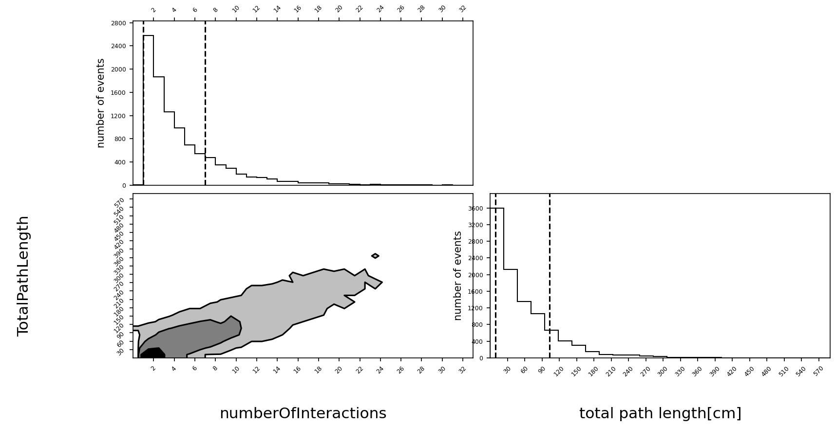
Only for primary neutrons (didn’t perform (n,n’))

Slide 28


Slide 29


Slide 30



$$E_{k}^{i}=2.5MeV$$
0 interaction neutrons
100k events
Back scattering peak
$$E_{k}^{f}=2.26 MeV$$

Slide 31

100k events

Slide 32



Distribution does not include secondary neutrons
Primary neutrons, $E_{n}^{i}=2.5MeV$
$$λ=11.97±0.06 cm$$
$$f\left(x\right)=A∙e^{−0.0836x}$$

Slide 33



Distribution also includes secondary neutrons
$$E_{n}^{i}=2.5MeV$$
pvalue=0.79
$$f\left(x\right)=A∙e^{−0.0677x}$$
$$λ=14.8±0.2 cm$$

Slide 34






Only for primary neutrons (didn’t perform (n,n’))
Of primary neutrons with $E_{k}^{i}=2.5 MeV$
$$f\left(x\right)=0.66x$$
No data here since this graph only looks at primary neutrons (trackID =1), meaning only neutrons which did not perform (n,n’), also really slow neutrons(low kinetic energy) can be captured by nuclei.
$$v=0.07∙c$$
No data here since neutron speed is capped at initial neutron speed with $E_{k}^{i}=2.5 MeV$
$$v=c$$

Slide 35




$$E_{k}^{i}=2.5MeV$$
Also includes secondary neutrons (n’)
$$f\left(x\right)=0.66x$$
$$v=0.07∙c$$
$$v=c$$

Slide 36

No protons exit the detector, though some are created in (n,p) process with Argon 36

Slide 37


Slide 38


Slide 39



1.46 MeV
⁴⁰Ar 2+ -> 0+
Minimum photon energy = 218 eV
⁴¹K created by ⁴¹Ar $β^{−}$decay
⁴¹Ar created by nCapture on ⁴⁰Ar
e-e+ created by pair production first and then annihilate to create gamma rays
659.9 keV
⁴⁰Ar 0+ band 2 -> 2+ band 1
^{1.29 MeV}
⁴¹K 7/2- -> 3/2 +
$e^{−}e^{+}→$2$γ$

Slide 40


Slide 41


Slide 42


Slide 43





$n′$
Primary $n$
LAr
$secondary γ$
$$\left(n,n^{′}\right)vertex$$

Slide 44



Slide 45


Slide 46



Slide 47


Slide 48


Slide 49



Creus et al. , JINST 10 (2015)
Consequence -
In the paper they neglect inelastic scatters because they use elastic kinematics in order to calculate nucleus recoil, and thus in 17% of events they have an error in their calculations.
Our geant4 simulation-
Emulating the LAr cell size(roughly)
neutron
50 mm
?

Slide 50




My geant4 simulator
Article experimental setup
$$θ$$
LAr cell
5’’ liquid scintillator
in the experiment there is also a 1.5mm aluminium layer around the sensitive volume of LAr, but the effect on the neutrons is minimal(sub percent)
Also, in reality the beam is collimated into 0.2% 4pi steradians which gives an effective surface area of $0.013 [cm^{2}]$ of neutrons hitting the LAr, and in my simulator I use a pencil beam (0 width)

Slide 51


Slide 52



Article experimental setup
Nucleus $E_{recoil}$ dist.
$$θ={25}^{∘}$$

Slide 53






$$0^{∘} scatter$$
$${90}^{∘} scatter$$

Slide 54




$${25}^{∘} scatter$$
$$θ$$

Slide 55

Liquid scintillator placed at ${25}^{∘}$ angle relative to LAr cell,
Showing the neutron scattering angle distribution within the active volume of the cell without external scatters

Slide 56


Comparison of my simplified simulator time of flight distribution for different event types vs Creus et al. , JINST 10 (2015)
General trend is the same.

Slide 57

After time of flight cut - $42 \left[ns\right]< time < 49 [ns]$

Slide 59


Slide 60





Slide 61

This work (simplified geometry)
Creus et al. , JINST 10 (2015)
Single elastic
Multiple elastic
Single elastic and external

Slide 62

https://www.sciencedirect.com/science/article/pii/S0927650516302341

Slide 63
In order to make sure we understand how to properly set the required parameters for scintillation light in geant4, we first want to make some sanity checks.
First and foremost, we want to see that the distribution of the amount of scintillation photons created matches the parameter we set for the SCINTILLATIONYIELD.
Doing this we run into a problem – we don’t seem to get the right amount of photons.
The following slides explain why that is

Slide 64


When setting the SCINTILLATIONYIELD of a material in geant4, geant takes into account the birks constant when calculating how many scintillation photons to produce in an event, even for electrons. This means you will see fewer scintillation photons than your input parameter.
Even if you set birks constant = 0, the physics package overrides and sets the LAr birks constant = 0.032 mm/MeV
This tracks according to the data we gathered – using the average path length of the primary electron in the detector(with ${E_{k}}_{i}=1MeV)$, we can calculate the light yield attenuation assuming birks constant = 0.032 using:
$attenuation=\frac{1}{1+0.032∙avg.path length}=1.007−1.009$
if you can the amount of scintillation photons per event, you can deduce the attenuation of the light yield by $\frac{51000}{num of scint photons}$
This comes out to be around 1.012 when checking each photon individually by its track and 1.008 using the process vector->GetNumPhotons method.

Slide 65


Using processVector->getNumPhotons
Checking each track individually

Slide 66

Finally, when setting birks constant to a really small number, but not 0, so that the physics package does not override it, you see a distribution centered around 51000 photons per event as expected:

Slide 67

Moving on, we want to perform extra sanity checks. We start by firing a 1 MeV electron directly in the center of our LAr cylinder.
Firstly, the emitted scintillation photons’ wavelength – this distribution matches the parameters we set – centered around 128nm wavelength for the emission spectra.

Slide 68

Next, looking at the emission timing of the scintillation photons, with fast component set to 7ns and slow component set to 1500ns:

Slide 69



Next, the scintillation photons’ angular distribution, separated to spherical angles $θ$and $φ$.

Slide 70

And finally, looking at the positions in which the scintillation photons were created and seeing they roughly match the track of the primary electron:

Slide 71



Now we can safely move on to try and fully recreate the findings of Creus et al.
We first try to emulate PMTS and coincidence between them in the following way – we ask how many photons reached each base of the LAr cylinder (in their research there are 2 PMTS surrounding each base), and in order to take into account the QE of the TPB and PMT we roll a random number in a uniform distribution in the range (0,1) and if it is < 0.25 we say the photon was absorbed inside the pmt.
In order to ask if there was coincidence between the PMTs, we look at the time difference of photons reaching the top PMT and the bottom PMT, and if in an event we get a time difference that is smaller than $\frac{c}{n∗h}$ (where c is the speed of light, n is the refractive index of LAr , and h is the height of the cylinder), we say that there is coincidence in the event.
The following plots are for a primary electron:

Slide 72




The following plots are for a primary proton:
The rest of the plots are pretty similar to the electron plots. The main difference is in the positions in which the scintillation photons are created – a proton primary deposits most of its energy over a very short distance relative to the electron, and so all scintillation photons are created very close to the center of the LAr cylinder (that is also the reason the scintillation yield is smaller for a proton relative to an electron)

Slide 73
The plan now is to go back and recreate table 4 from the swiss paper.
This requires calculating the light yield from nuclear recoils and from electron recoils at 6 different energies.
For neutrons the light yield is calculated for the 6 different scattering angles in the time of flight cut (in order to isolate elastic events). The PMT QE is roughly 15% according to Creus et al. , and the reflector used “is nearly a 100% diffuse Lambertian reflector” [The ArDM Collaboration et al 2009 JINST 4 P06001]. We will set the reflectivity between 97-98%.
In order to calculate the light yield for the electron recoils, we will first make a calibration graph. We will use the 60keV photopeak from 241Am, 122 keV photopeak from 57Co, and the 341keV, 478keV and 1061keV Compton edges from 22Na, 137Cs and 22Na respectively.

Slide 74

Calculating Compton edges for 22Na, 137Cs gamma rays:
In a Compton scattering process, an incident photon collides with an electron in a material. The amount of energy exchanged varies with angle, and is given by the formula:
$$E^{′}=\frac{E}{1+\frac{E}{m_{e}c^{2}(1−\cos\left(θ\right))}}$$
E is the energy of the incident photon
E’ is the energy of the outgoing photon
$θ$ is the angle of deflection for the photon.
The energy of the electron is then calculated by E – E’, and a Compton edge is formed at a deflection angle of 180 degrees.
Thus, $E_{ce}=E −E^{′}\left({180}^{∘}\right)=E (1 −\frac{1}{1+\frac{2E}{m_{e}c^{2}}})$
Plugging the numbers for gamma rays with energies 511keV, 662keV and 1274keV we get Compton edges :
Compton Edge (511keV) = $\frac{2}{3}E=341keV$
Compton Edge (662keV) = $0.72E=478keV$
Compton Edge(1274keV) = $0.833E=1061keV$

Slide 75

If we were to look at the energy deposit of the photon, we would expect to see a sharp drop off at the photopeak energy , like this:
We now want to be able to extract the light yield from this histogram.

Slide 76


If we were to look at the energy deposit of the photon, we would expect to see a sharp drop off at the photopeak energy , like this:
But since the amount of scintillation photons created (and thus absorbed) per event varies around the mean by the parameters we set - $0.11∗\sqrt{mean}$, in order to calculate the light yield from the scintillation histogram, we don’t take the peak value, we take 1.11 * peak value.
We do this for every single photon energy.

Slide 77

Photopeak
Compton Edge
With 122keV photon we first see a Compton edge on the left, and then a photopeak on the right.

Slide 78



At higher photon energies we can no longer see a photopeak, since the Compton scatter integral is considerably larger than the photopeak.

Slide 79







$$1061 keV$$
$$y=3.2x −11.6$$
$$478 keV$$
$$341 keV$$
$$122 keV$$
$$60 keV$$

